Slide 1

PolyU Campus Store Online Platform
GROUP 9
CHEN ZIYANG 21095751D
LI SHUHANG 21102658D
WANG WOKAI 23085034D
XIE YUEXI 23122044X
YE CHENWEI 21103853D

Slide 2

1 Description
2 Achieved Functions
3 Web Structure
4 Demonstration

Slide 3

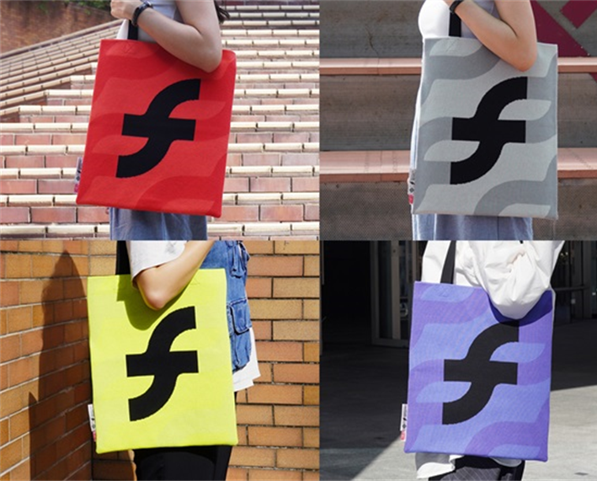
DESCRIPTION
The PolyU Campus Store online platform sells PolyU souvenirs, gifts, stationery and original products by PolyU design students and teachers. Our website is user-friendly for customers, with multiple features such as search, shopping cart, submitting feedback, and more.

Slide 4

2. Achieved Functions

Slide 5

User registration and log-in
Search function
Achieved
Functions
Shopping cart function
Feedback and comment

Slide 6

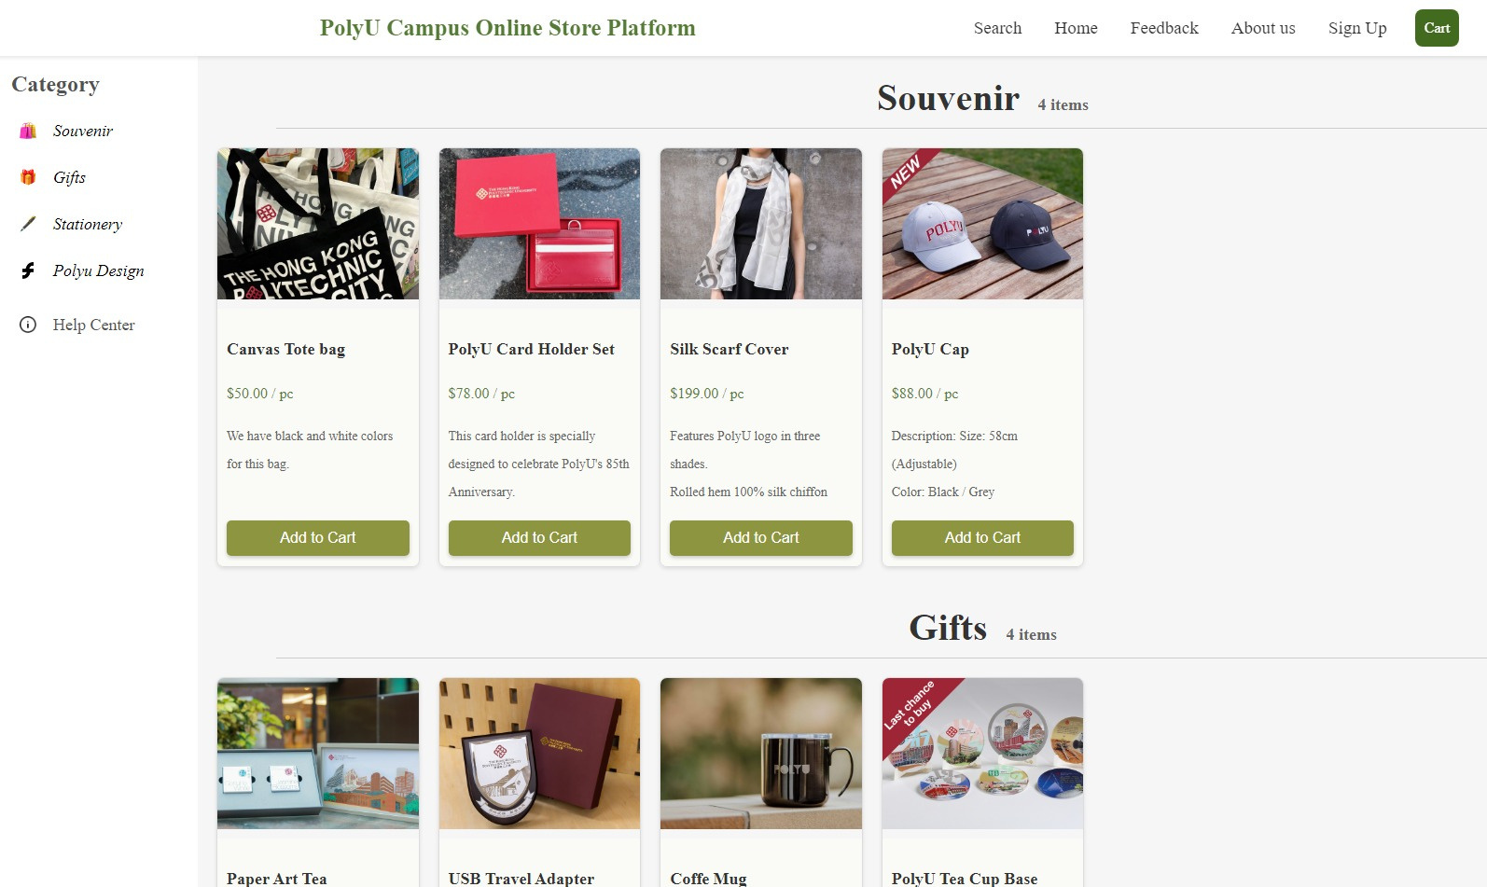
Homepage

Slide 7
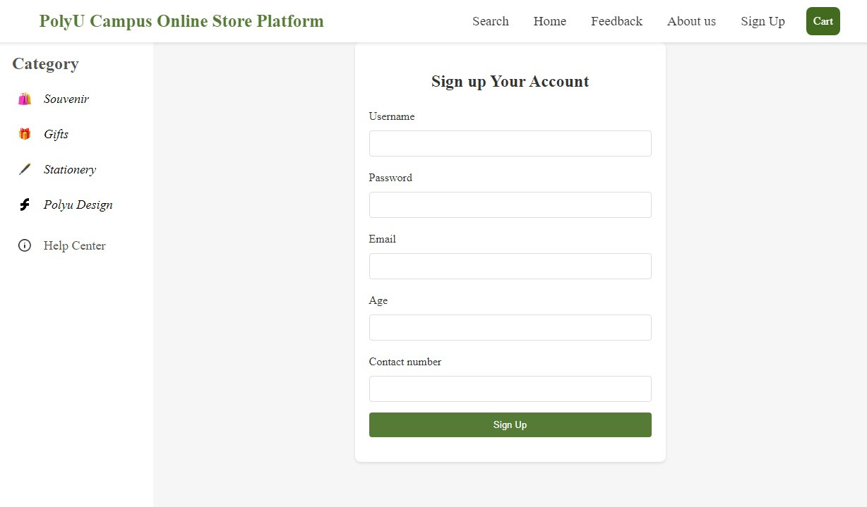
Sign up

Slide 8

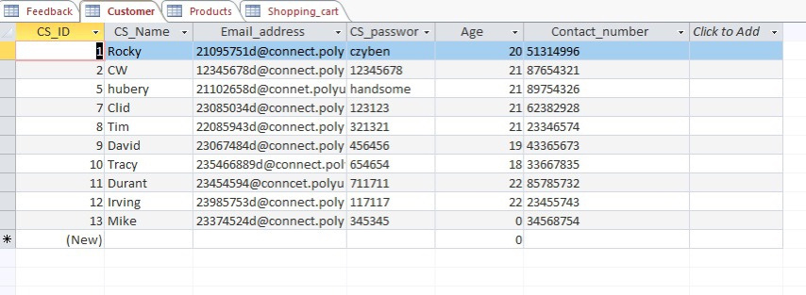
Tables
Customer information

Slide 9
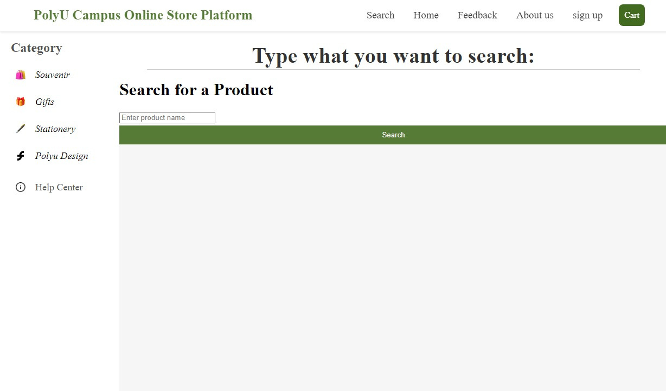
Search

Slide 10
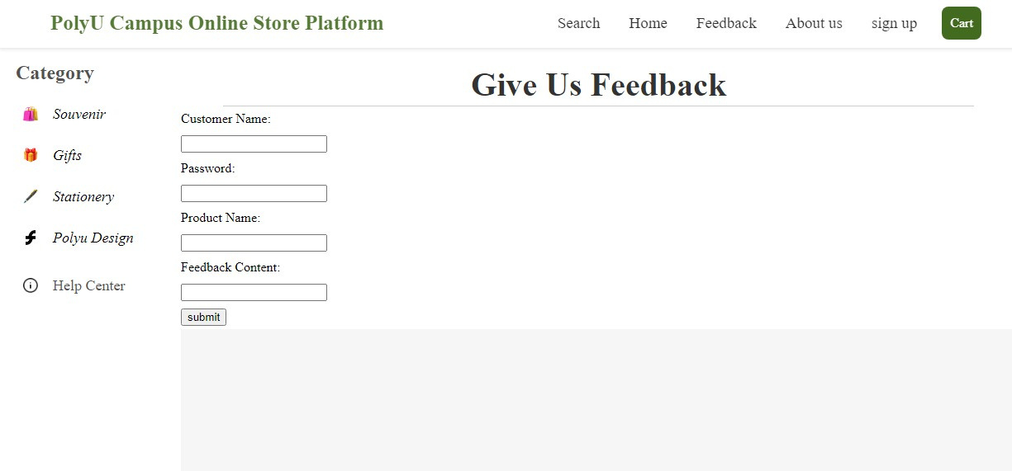
Feedback page

Slide 11
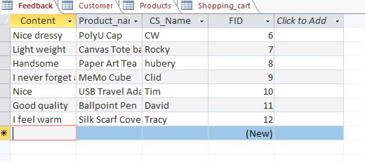
Tables
Feedback

Slide 12
Homepage

Slide 13
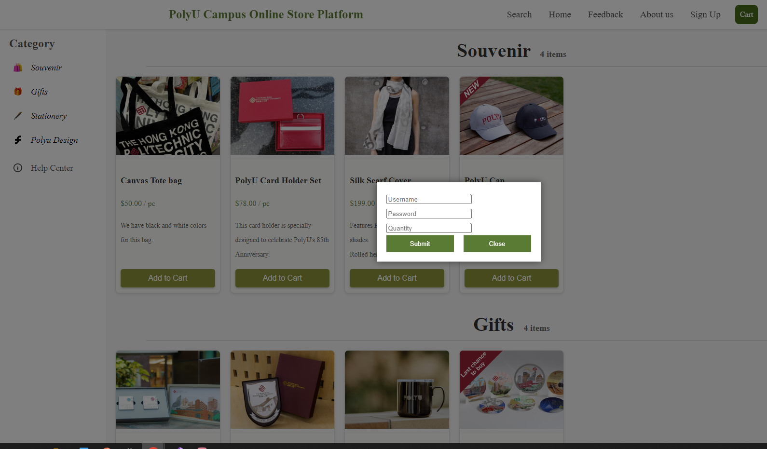
Add items to Cart

Slide 14
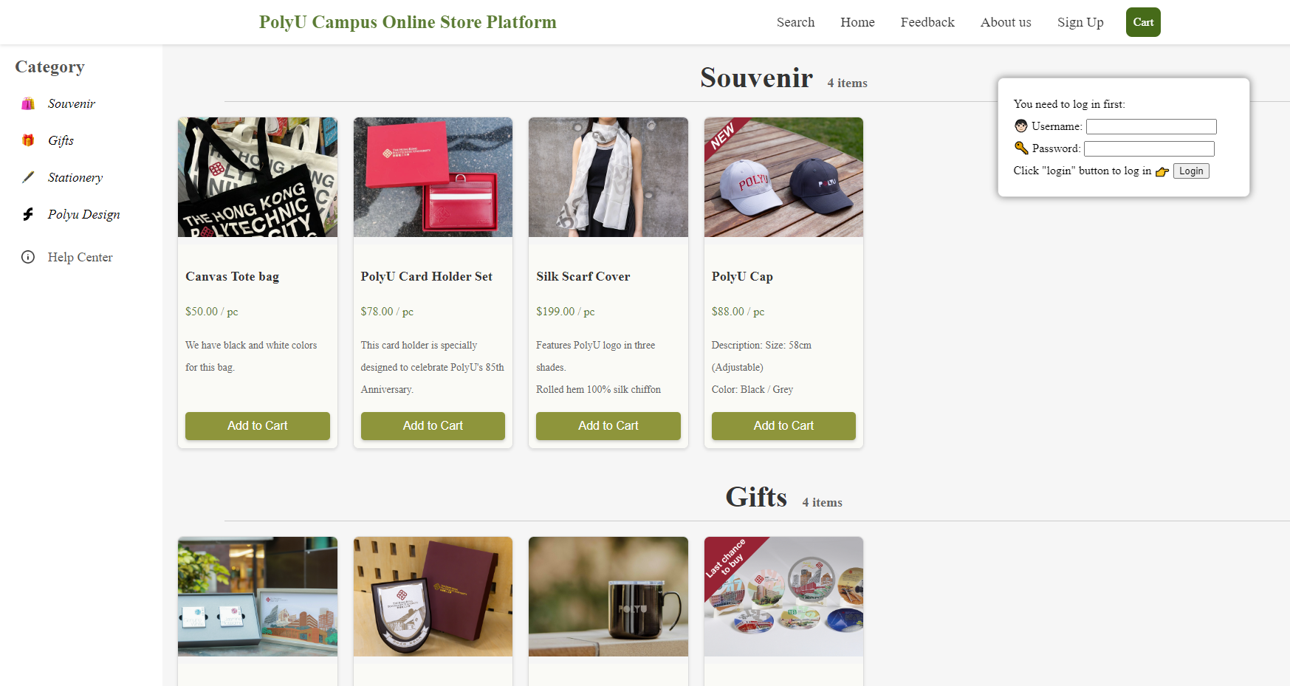
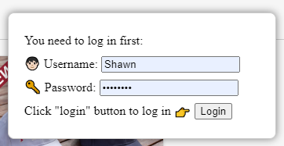
Check Shopping Cart

Slide 15
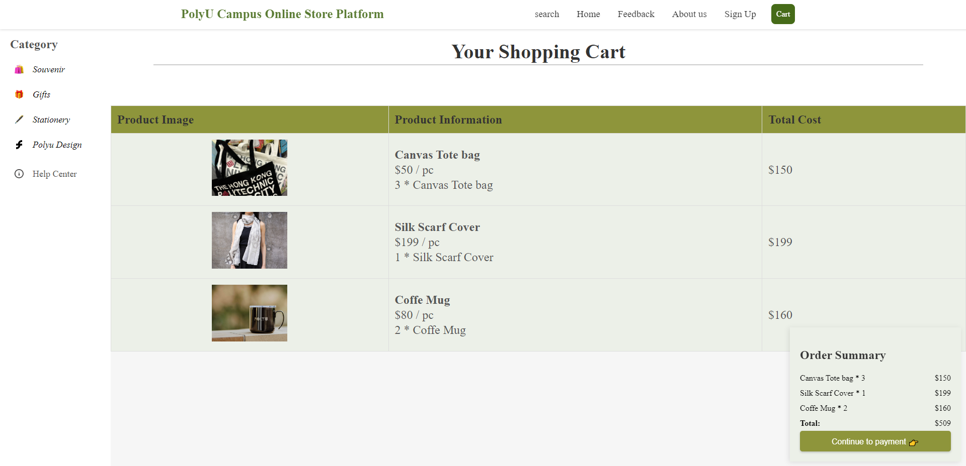
Check Shopping Cart

Slide 16
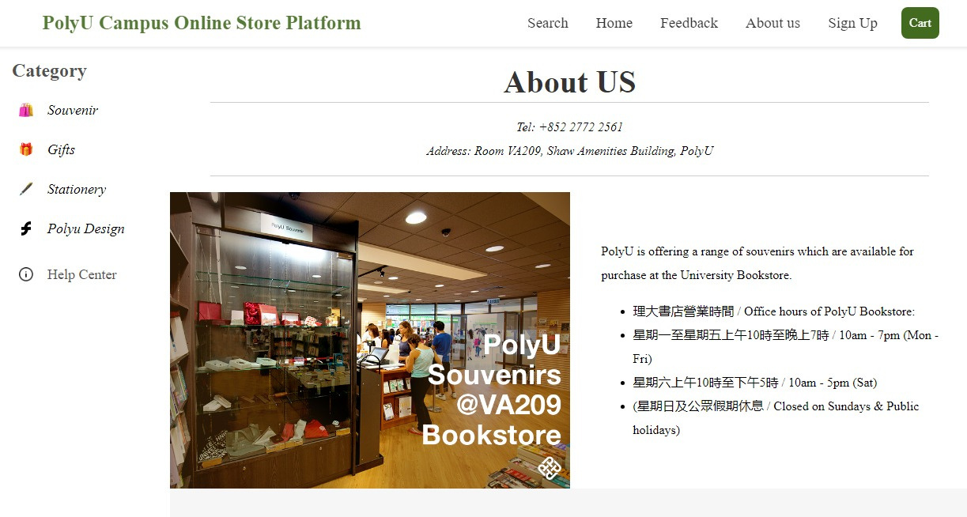
About us

Slide 17

3. Web structure

Slide 18
3-tier Model
HTML & JAVASCRIPT: Display the content，User interaction and accepting user input
ASP: Handle logic and data interaction
DATABASE: Data storage and management

Slide 19
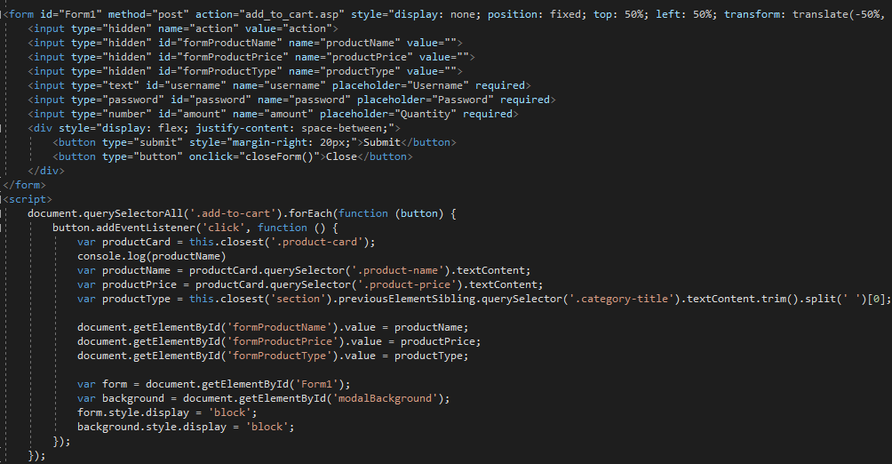
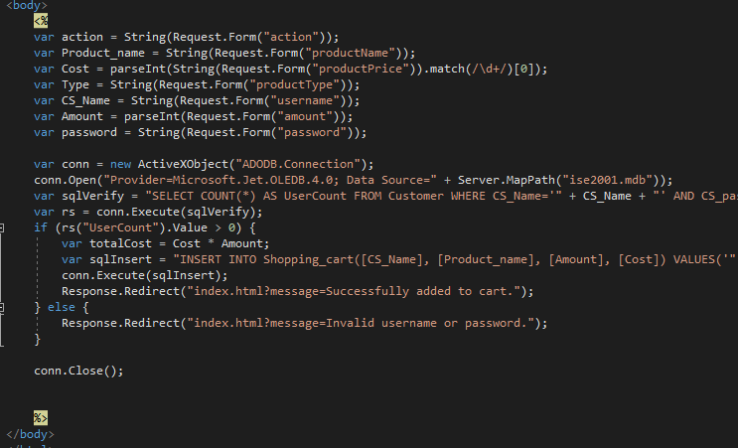

HTML & JAVASCRIPT
ASP

Slide 20
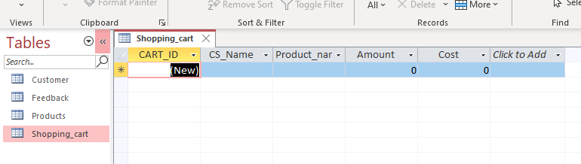

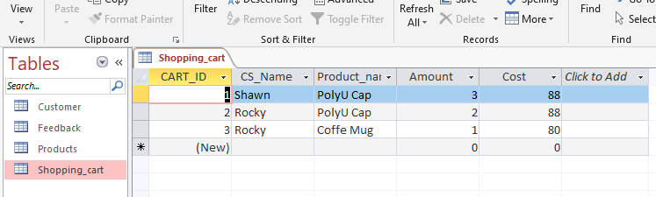

Before:
After:

Slide 21
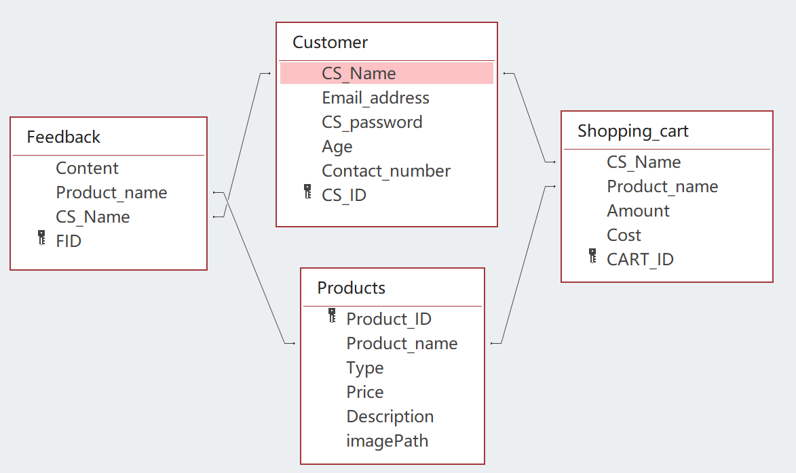
Table Relationship

Slide 22
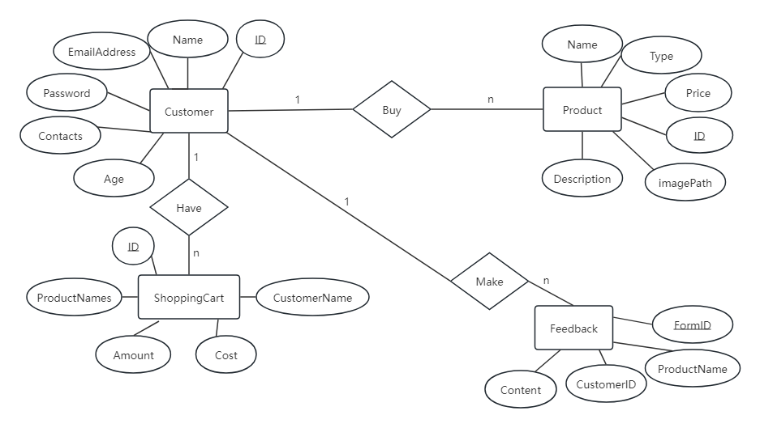
ER diagram

Slide 23
Tables
1. Customer information

Slide 24
Tables
2. Feedback

Slide 25
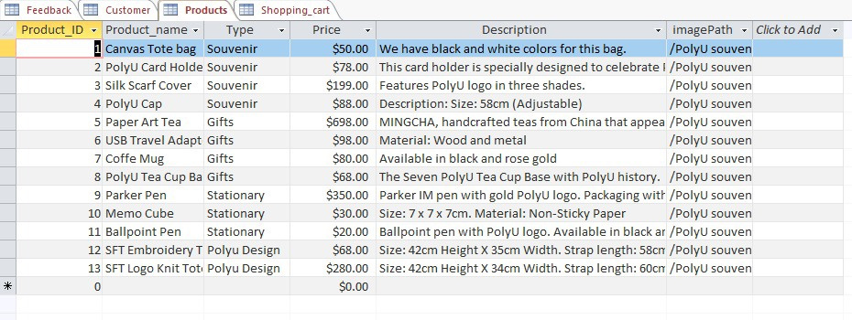
Tables
3. Product Information

Slide 26
Tables
4. Shopping cart

Slide 27
Demonstration

Slide 28
THANK YOU

